Slide 1
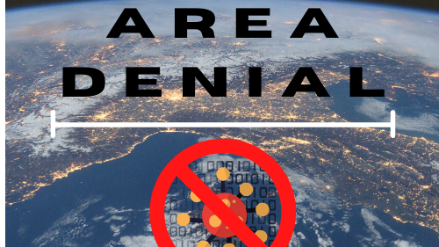
Click once to play the whole slideshow

Slide 2

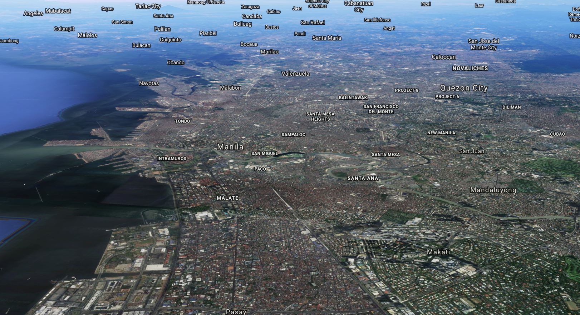
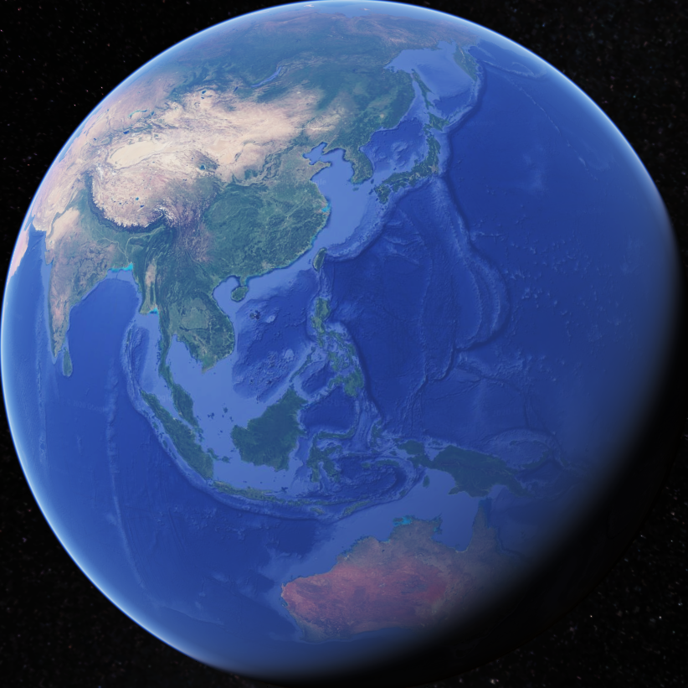
We are building a website that predicts the number of COVID-19 cases in a city
pixelstalk.net
Notes:
We will be building a website that predicts how much of a COVID-19 hotspot a city is

Slide 3
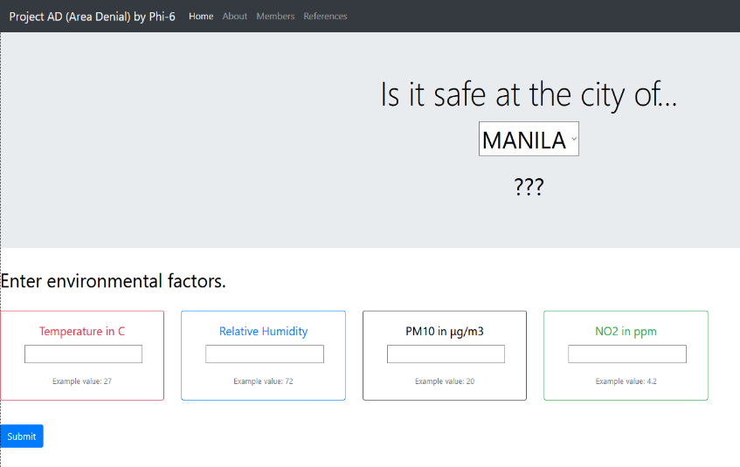
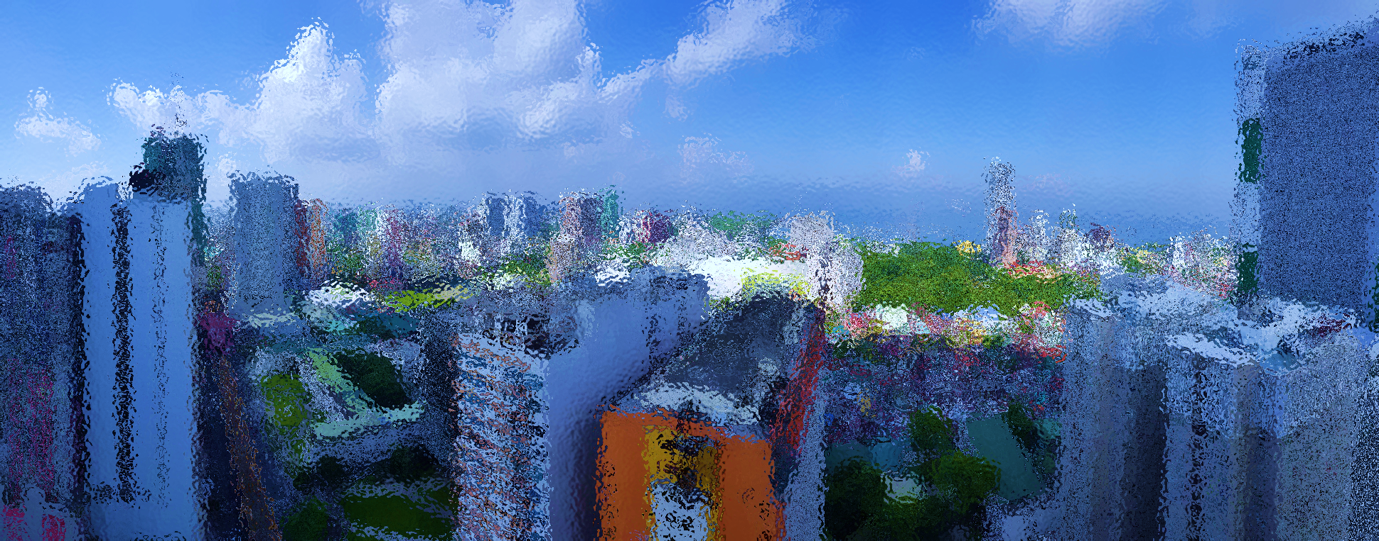
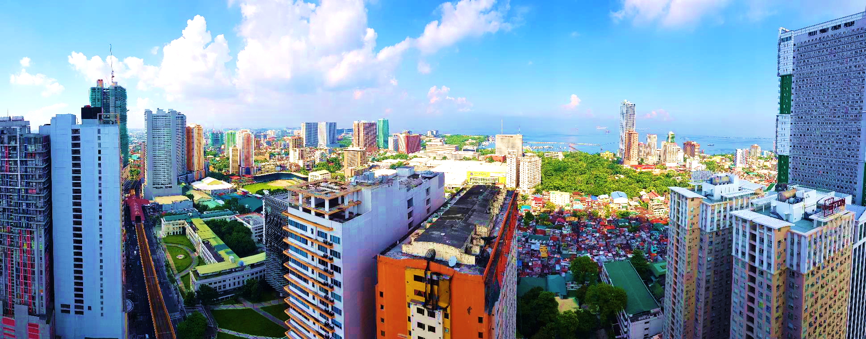








By inputting atmospheric
and epidemiologic data…
Temperature
COVID-19 Cases
Humidity
and with
computations using
“Random Forest
Regression
Technique”…
PM10
NO₂
Notes:
By combining a city’s atmospheric data, specifically air temperature, Humidity, PM 10, NO2 pollutants, and that city’s population and COVID-19 cases, we can get an idea on how safe a city is in relation to the risk of a person acquiring COVID.
-This risk is then quantified into an easy-to-understand quantity that we call “Hotspot Percentage”

Slide 4

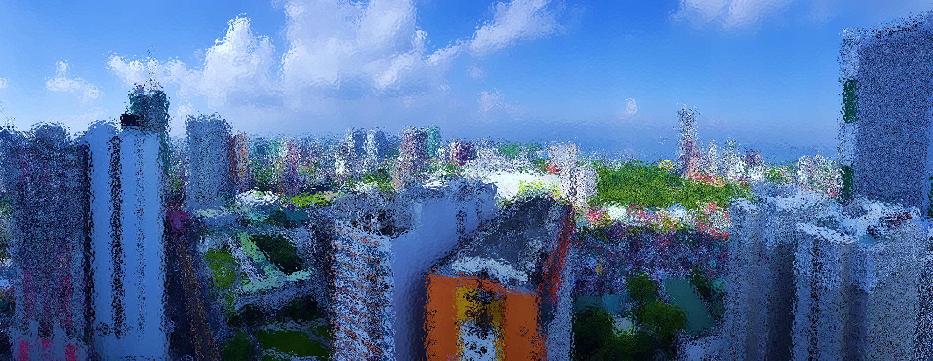
By inputting atmospheric
and epidemiologic data…
and with computations using “Random Forest Regression Technique”…
We can make predictions on how much risk an
individual may contract COVID-19,
in a specified city at a given time

Slide 5
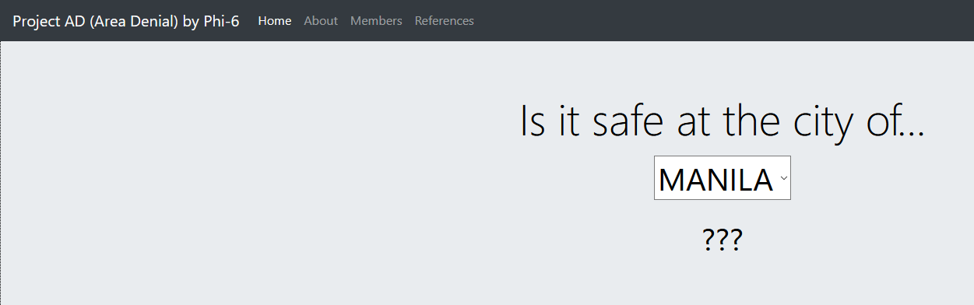
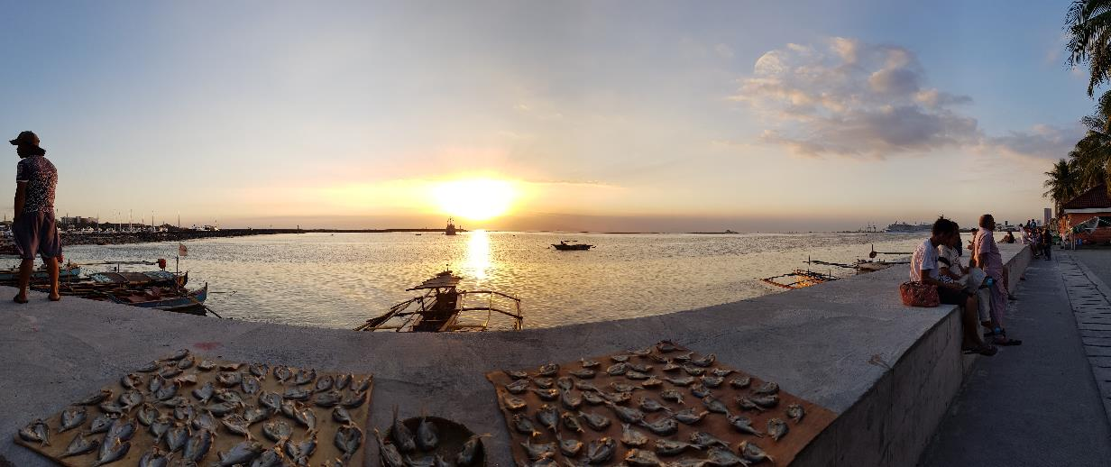
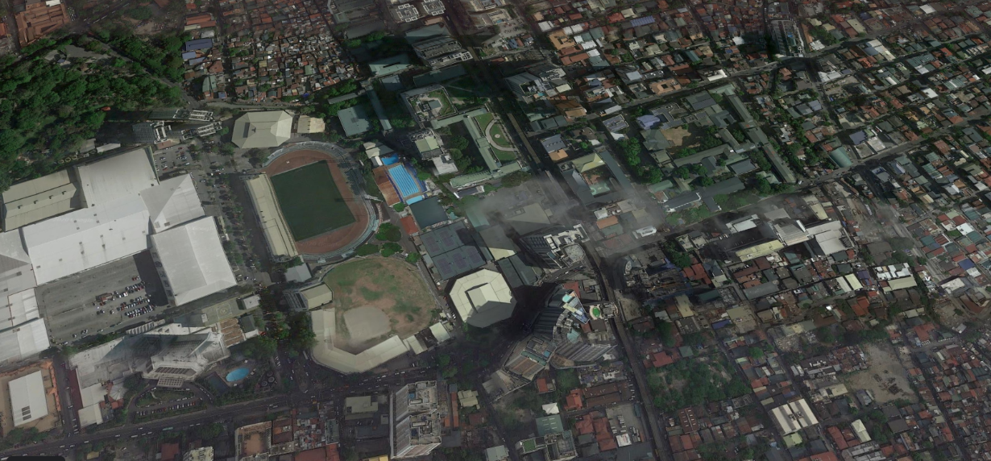
We can make predictions on how much risk an
individual may contract COVID-19,
in a specified city at a given time
Local government
officials can be guided
in their decisions
before restricting or
allowing access to a
city. Furthermore, the
national government
and policy-makers are
then able to predict
which cities need more
healthcare resources.
By using this website,
citizens will be guided
on what cities are “safe”
to visit, especially for
employees who
commute daily into and
out of Metro Manila
cities.
Thank you for watching.

